Slide 1
Head First
Chapter-3:
Know Your Variables
Upcode Software
Engineer Team
-2023-

Slide 2
CONTENT
Variables in Java
Primitive data type
Reference data type
What is garbage collectible heap?
Reference vs Primitive
Used materials and references

Slide 3
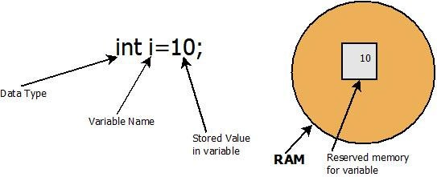
Variables in Java(1/n)
In Java, Variables are the data containers that save the data values during Java program execution.
Variables must have a type!
Variables must have a name!
Variable, in simpler terms, is a name given to a memory location.

Slide 4
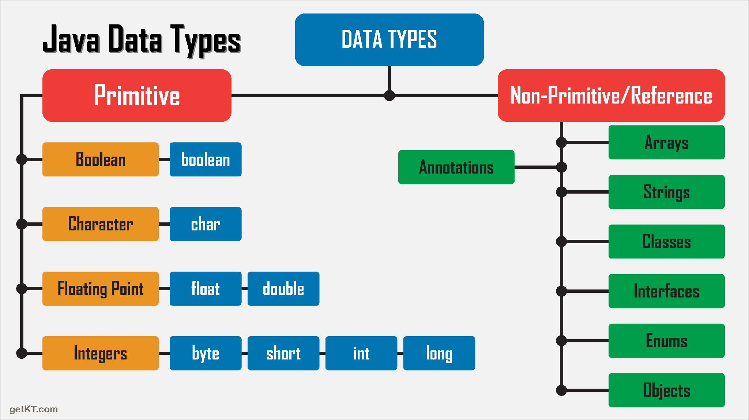
Variables in Java(3/n)
In Java, variables come in two flavors: primitive and reference
All the variables must declare with variable type and name.

Slide 5
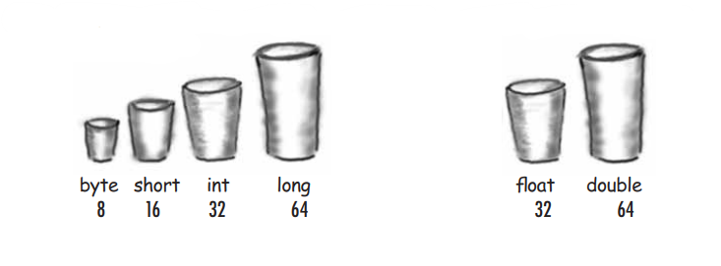
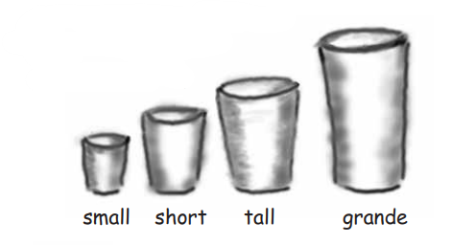
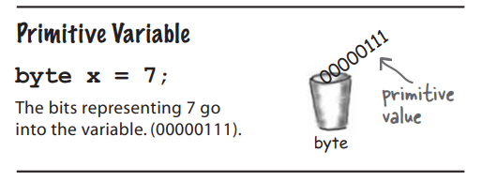
Primitive data type (1/n)

Slide 6
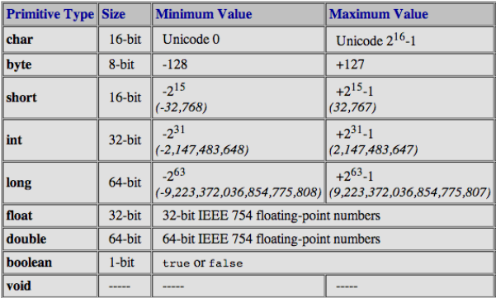
Primitive data type(2/n)

Slide 7
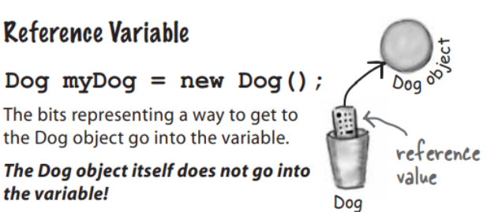
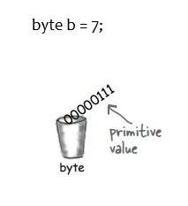
Reference data type (1/n)
The object reference variable holds bits that represent a way to access an object.
Object reference variable like remote control of an object and It has a type but it doesn’t have exactly a size.

Slide 8
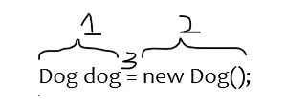
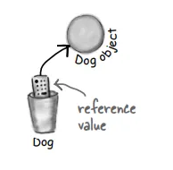

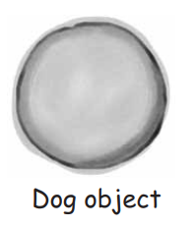
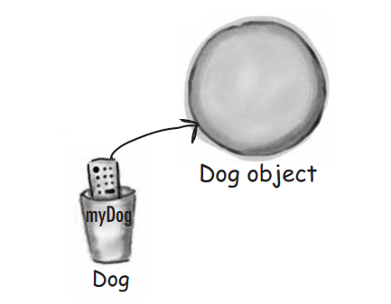
Reference data type (2/n)
1 → Declaration —Tell the JVM to allocate space for the reference variable whose name is the dog and Whose type is Dog forever.
2 → Creation — Tell the JVM to allocate space for a new Dog object on the heap.
3 → Assignment — Assign a new Dog object to the dog reference variable.

Slide 9
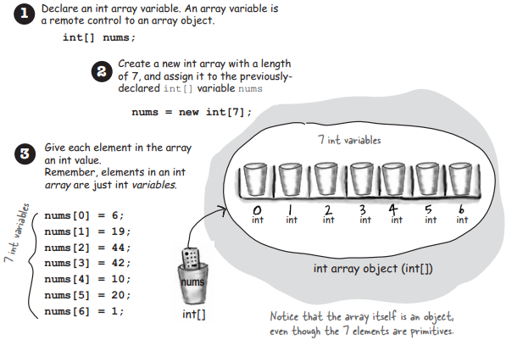
Reference data type (3/n)

Slide 10
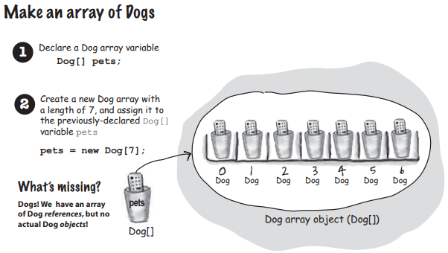
Reference data type (4/n)

Slide 11
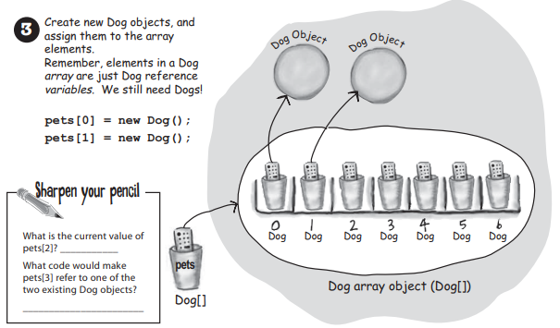
Reference data type (5/n)

Slide 12
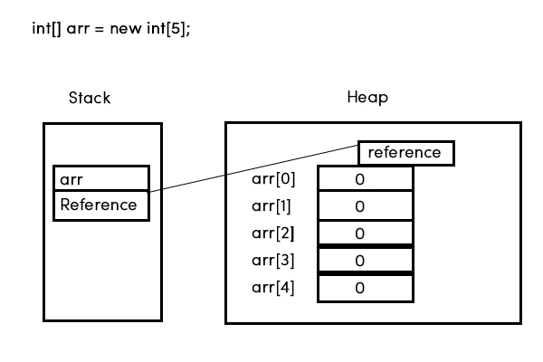
Reference data type (6/n)

Slide 13
Reference data type (7/n)
Each element will occupy the memory space required to accommodate the values for its type, i.e.; depending on the data type of the elements, 1, 4, or 8 bytes of memory are allocated for each element. The next memory address is assigned to the next element in the array.
Minimum object size is 16 bytes for modern 64-bit JDK since the object has 12-byte header, padded to a multiple of 8 bytes. In 32-bit JDK, the overhead is 8 bytes, padded to a multiple of 4 bytes.
That's not specified by the Java standard and thus you should not worry about it. Technically, references are usually as big as the machine's word size, i.e. 32 bit on a 32 bit machine and 64 bit on a 64 bit machine, though some 64 bit JVMs use special magic to allow 32 bit references.

Slide 14
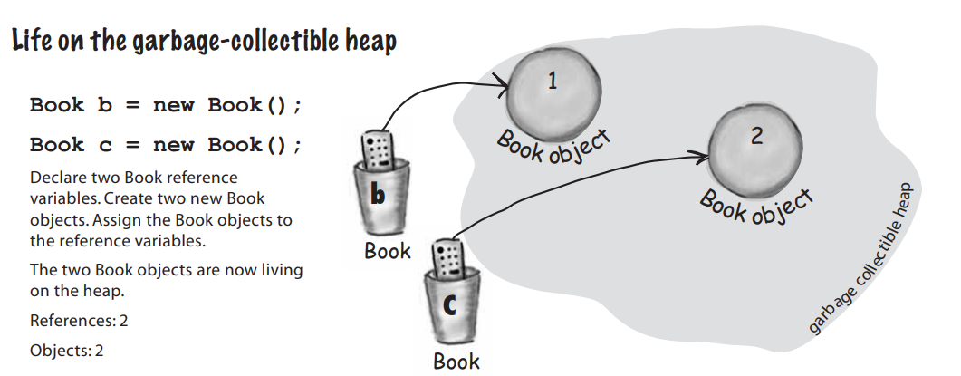
What is garbage collectible heap?(1/n)

Slide 15
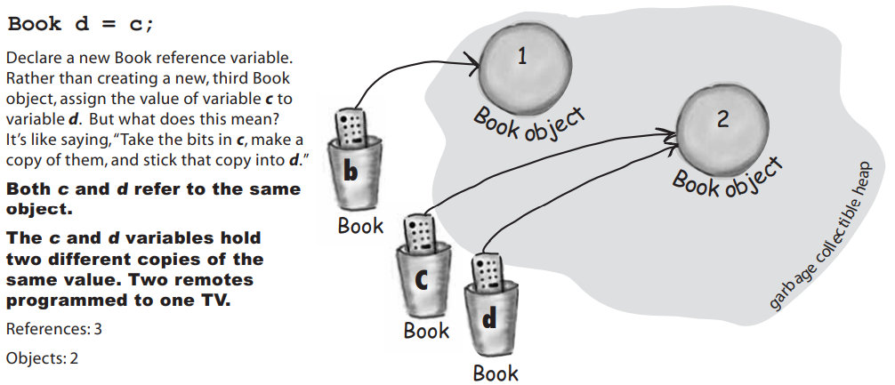
What is garbage collectible heap?(2/n)

Slide 16
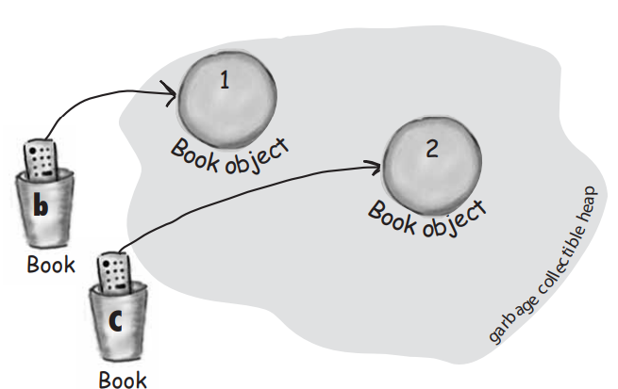
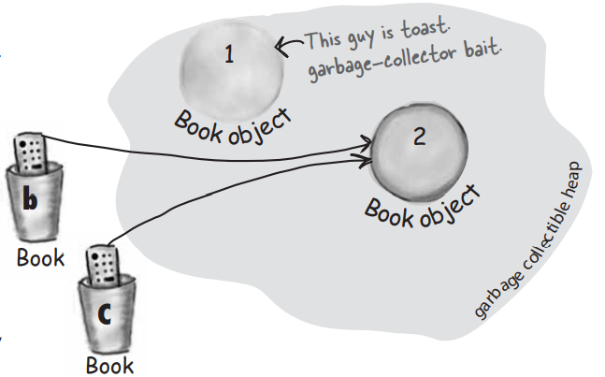
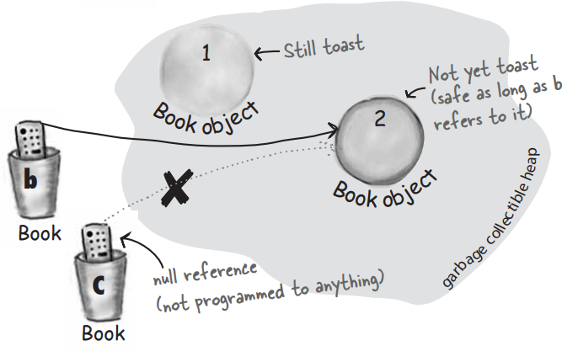



What is garbage collectible heap?(3/n)

Slide 17
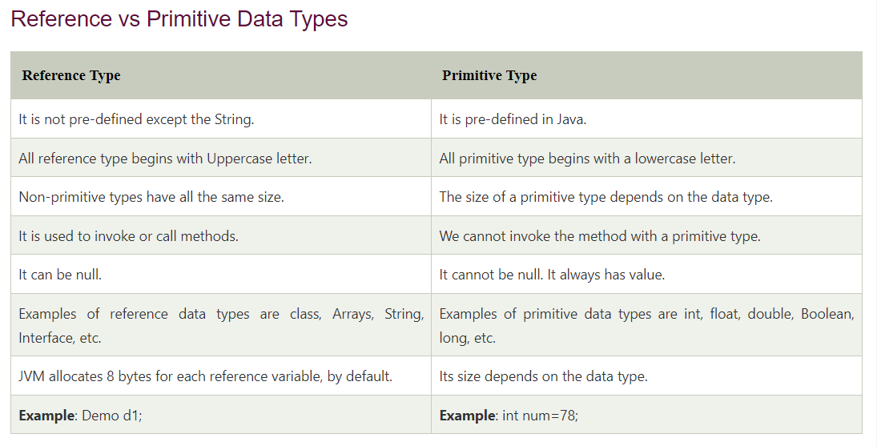
Reference vs Primitive

Slide 18
Thank you!
Presented by
Jamshid Erkinov
(jamshiderkinov19992206@gmial.com)

